Slide 1
Association & Foundation Update Class Advisory Senate
Jan. 21, 2025

Slide 2
2024 Highlights
Single Employer
Checkpoints- Best in Class
Young Alumni Ambassador Program
All Academy Awards Program – Long Blue Line Weekend
11 Reunions/6,000 Guests/6 Weekends
Class of 1970 Endowment for Reunions
Added 2,239 New Members = 72%
Branding Logo Work
Completed Campaign

Slide 3
2025 Areas of Focus
Election
Madera Cyber Innovation Center
Wecker Hall/Yost Plaza
Acclimate New EVP Alumni Relations
Grow Membership
Next Gen

Slide 4
Here’s A Toast: Gone But Not Forgotten Class Advisory Senate
Jan. 21, 2025

Slide 5
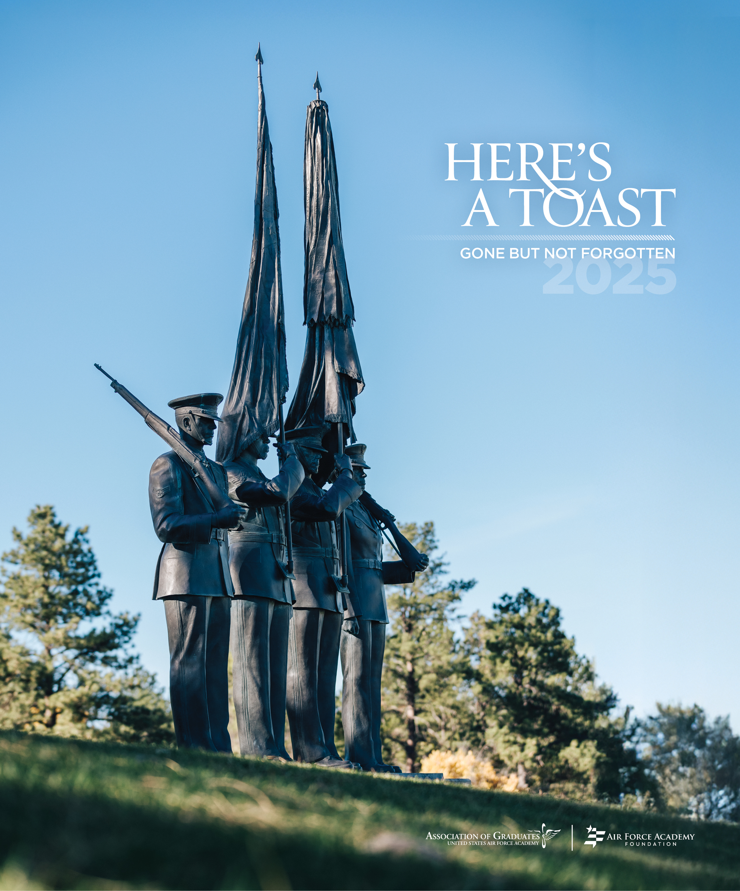
New Publication
Launching early spring 2025
Similar to West Point’s Taps
Memorial tributes for grads, ATOs, cadets and honorary members lost in previous calendar year
Articles up to 400 words in year 1; up to 800 in year 2
Digital (free) and print (nominal fee)

Slide 6
Availability
Digital – Available to all members at no cost on USAFA.org this spring
Print – Available to all members for nominal fee of $25 at shop.USAFA.org – covers costs + 1 complimentary copy for each family
Pre-orders for print open through Jan. 29
Individual keepsakes on parchment available for $15 – covers costs
Death notices will still run in Checkpoints and on GBNF website

Slide 7
Why?
Hard reality – aging grad population; increasing number of submitted obituaries – “hockey stick”-like curve; get in front of it now
Checkpoints limitations – costs rising; 144-page limit
Meaningful investment in Gone But Not Forgotten program
New benefit that surviving loved ones and friends will appreciate

Slide 8
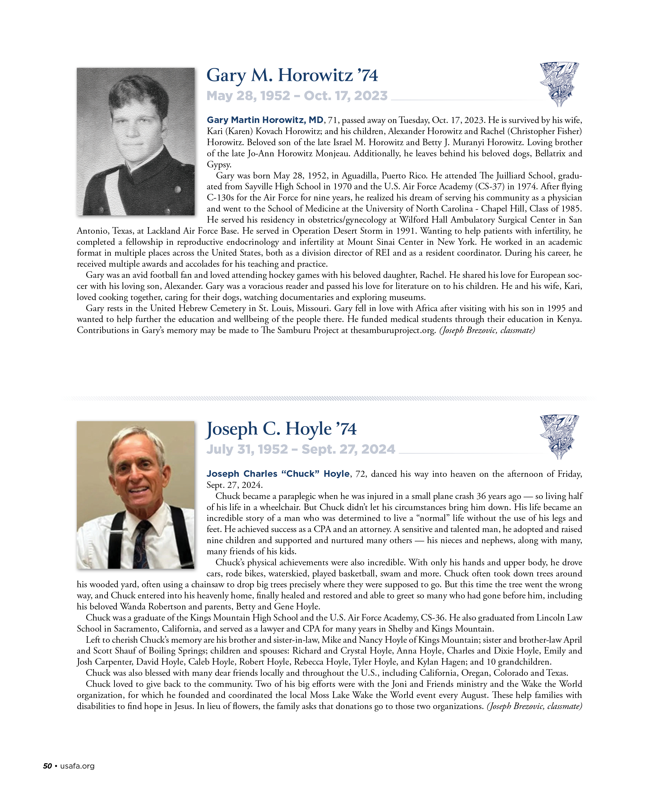
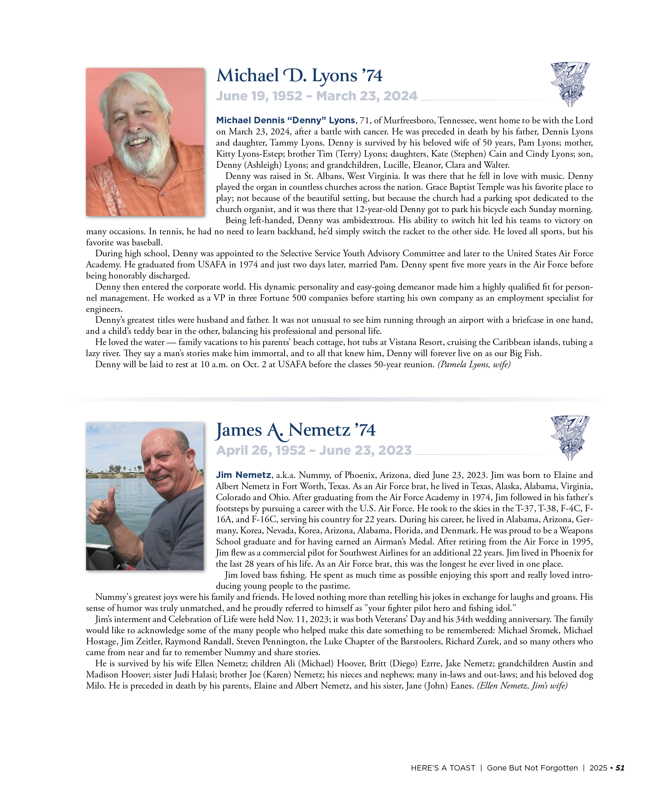
Mock-Ups

Slide 9
How Are We Communicating This?
Checkpoints – all 4 issues in 2024 + March 2025
ZoomiEnews
USAFA.org
Eblasts
Class Advisory Senate
No negative feedback so far

Slide 10
Thank You

