Slide 1
CLASS ADVISORY SENATE
Quarterly Update
18 July 2023
Naviere Walkewicz ‘99
Senior Vice President, Alumni Relations
Air Force Academy Association and Foundation

Slide 2
Long Blue Line Leadership Conference & Weekend
1DAY1USAFA
Upcoming Events

Slide 3
LONG BLUE LINE LEADERSHIP CONFERENCE
Formerly known as the Chapter President Conference, the Long Blue Line Conference connects leaders, provides updates on the AOG, Foundation and Academy, and provides resources to best support and serve our USAFA community.
This conference helps to cultivate a stronger, informed and more connected graduate network.
CONFERENCE DETAILS:
When: July 26-27, 2023
Where: The Dean’s House and Polaris Hall
Who: Chapters, Affinity Groups, CAS, Scribes, USAFA Faculty/Staff and Board Directors
Est. Attendance: 50-75 attendees

Slide 4
CONFERENCE AGENDA
WEDNESDAY, JULY 26TH
5:00 PM – Welcome Reception at the Dean’s House
THURSDAY, JULY 27TH
8:00 AM – Welcome & Check in at Polaris Hall
9:00 AM – AOG & Foundation Update with Senior Leadership
10:00 AM – Break
10:15 AM – High Quality Connections, Dr. Dickman, CCLD
12:00 PM – Lunch
1:00 PM – USAFA Guest Speaker, Lt. Gen. (Ret) Bj Shwedo
2:00 PM – Break
2:15 PM – Long Blue Line Portal Demo
3:00 PM – Brainstorming Session with Groups
4:00 PM – Closing Remarks

Slide 5
A homecoming experience where we welcome back all graduates to USAFA for a weekend of celebration, heritage, and connection. The Long Blue Line Weekend offers multiple events targeting the wide range of interests from our constituents and helps cultivate a stronger and more connected community.

Slide 6
Long Blue Line Weekend
GRAD MARCH BACK
When: Friday, July 28th
Where: USAFA/Jacks Valley
Who: USAFA Graduates
Est: 175 attendees
EVENING SOCIAL/TASTING
When: Friday, July 28th
Where: Doolittle Hall
Who: USAFA Graduates & Guests
Est: 100 attendees
PLANETARIUM SHOWING
When: Saturday , July 29th
Where: USAFA Planetarium
Who: USAFA Graduates & Guests
Est: 110 attendees

Slide 7
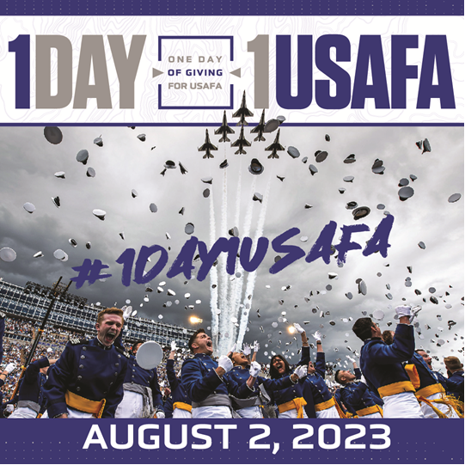
1DAY1USAFA is our annual day of giving.
Our goal is for 2,000 grads to give.
Donate to any fund at any amount.
Share 1Day1USAFA with classmates and anyone else who is a part of the Academy community.

Slide 8
Upcoming Events
JULY
26-27: Long Blue Line Leadership Conference
28-29: Long Blue Line Weekend
AUGUST
2: 1DAY1USAFA
9: Class of 2025 (and Legacy Class of 1975) Commitment Dinner
12: Distinguished Graduate Dinner
17-18: Service Academy Career Conference (SACC) – San Diego, CA
SEPTEMBER
14-16: Reunion Weekend (1968, 2013)
28-30: Reunion Weekend (1973, 1983, 1998, 2003)
OCTOBER
12-14: Reunion Weekend (1988, 1993)
20-21: Falcon Nation: BEAT NAVY! (YA Excellence Award Event & Social, Tailgate & Game) – Annapolis, MD
NOVEMBER
2-4: Reunion Weekend (1978, 1959-1962 – modified)
3-4: Falcon Nation: BEAT ARMY! (Grad Social, Tailgate & Game) – Empower Stadium (Denver), CO

