Slide 1
Long Blue Line Weekend Highlights July 25-28
Jacks Valley Marchback
Lunch with Cadets & USAFA Leader’s Brief
Long Blue Line Awards Dinner – Jabara Airmanship, Leadership Achievement Award, and Young Alumni Excellence Award
Long Blue Line Leadership Conference
Saturday Guest Speakers
Brigadier General Letendre ’96, Dean of the Faculty
Lieutenant General (Ret) Shwedo ’87, Director, Institute for Future Conflict
Colonel Pipes ’98, USAFA Director of Admissions
Colonel Alexander ’99, Chief of Cadet Wing Training and Support
Colonel (Ret) Primas ’92, Prep School Deputy Director
Young Alumni Panel: Captain Jacob DeRuyter ’15, Captain Joshua Surver ’18, Captain Audrey Reed ’19

Slide 2
Long Blue Line Weekend Highlights July 25-28
Sunday Guest Participants (Interactive)
Lt Col (Ret) Greg Shuey ’68 – KC AOG Chapter
Lt Col (Ret) Lee Curtis – ‘85 Central Oklahoma Chapter
The Honorable Mike Rose ’69 – SC Chapter
The Honorable Kevin Divers ’98 – Tennessee Chapter

Slide 3
Upcoming Events
Aug 21 - Long Blue Line/Long Gray Line Social in San Diego
Aug 22-23 - Service Academy Career Conference San Diego
Aug 23 - Next of Kin Ceremony
Aug 29 - WebGuy Social
Aug 31 - Falcon Nation Tailgate
Aug 30-Sep 2 - Parent’s Weekend
www.USAFA.org/Events

Slide 4
Reunions
Aug 13-15: 1964
Sept 11-15: 1969
Sept 26-29: 1979
*Oct 2-5: 1974, 1984, 1989
*Oct 17-19: 1994, 1999, 2004, 2014
Oct 30-Nov 3: 1991 (Hawaii)
https://reunions.usafagroups.org/

Slide 5
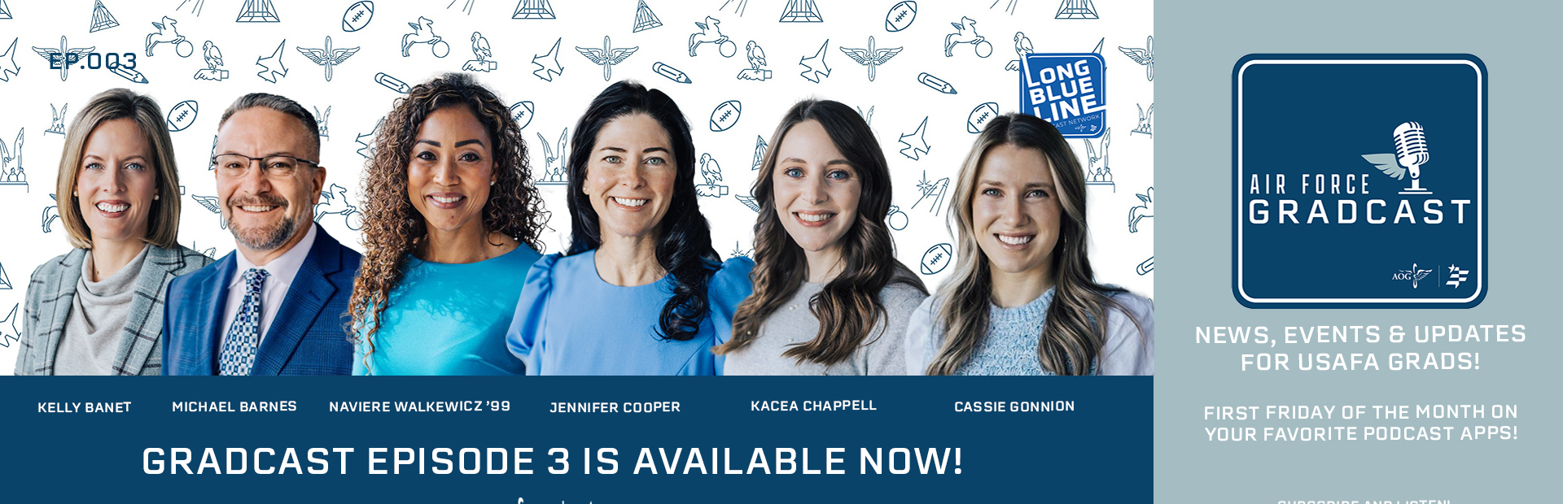
GradCast
What is GradCast?
AOG and Foundation news, updates, impact, people, special features and events!
Stay connected to the Long Blue Line and your alma mater
Gradcast drops the first Friday of every month
Available on all your favorite podcast apps
Listen and share Gradcast with your network of Academy grads, family and friends!

